Slide 1
String
Xu Yanyan

Slide 2
String
Commonly used string functions
Hashing strings
Trie (retrieval, digital tree or prefix tree)
The KMP algorithm -> BM (omitted)
The Aho–Corasick algorithm
Suffix tree and suffix array (optional)
Solve most string problems: find substring, the longest repeated substring, the longest common substring, etc.

Slide 3
Commonly used string functions
Basic operations of strings:
Read
Find
Replace
Number and string conversion
…

Slide 4
C: getchar() & gets()
Read a character:
char ch1;
ch1=getchar();
Read a string:
char str[1002];
gets(str);

Slide 5
C++ string
Read a string and replace all "you" with "we”.
#include<bits/stdc++.h>
using namespace std;
int main(){
string str;
int pos;
while(getline(cin, str)){
while((pos=str.find("you")) != -1)
str.replace(pos, 3, "we");
cout<<str<<endl;
}
return 0;
}

Slide 6
int to string
sprintf <cstdio>
to_string <string>
stringstream <sstream>
to_chars <charconv> C++17

Slide 7
/* sprintf example */
#include <stdio.h>
int main ()
{
char buffer [50];
int n, a=5, b=3;
n=sprintf (buffer, "%d plus %d is %d", a, b, a+b);
printf ("[%s] is a string %d chars long\n",buffer,n);
return 0;
}

Slide 8
// to_string example
#include <iostream> // std::cout
#include <string> // std::string, std::to_string
int main ()
{
std::string pi = "pi is " + std::to_string(3.1415926);
std::string perfect = std::to_string(1+2+4+7+14) + " is a perfect number";
std::cout << pi << '\n';
std::cout << perfect << '\n';
return 0;
}

Slide 9
#include<iostream>
#include<sstream>
using namespace std;
int main(){
istringstream iss("12 34");
int a, b;
iss >> a >> b;
cout << a << " " << b << endl;
string str;
ostringstream oss;
oss << a << " " << b;
str = oss.str();
cout<<str;
return 0;
}

Slide 10
Hashing strings
Hashing strings is to use a hash function to hash each string to a different number, that is, an integer value.

Slide 11

How to design a string hash function?
In order to reduce collisions, each character in the string should participate in the hash value calculation.
Should have avalanche effect: Changing only one character in the string may have a great impact on the hash value.

Slide 12
BKDR Hash Function
unsigned int BKDRHash(char *str) {
unsigned int seed=31,key=0; // 31 131 1313 13131 131313 etc.. while(*str)
key = key*seed+(*str++);
return key & 0x7fffffff; // return a 31-bit value
}
Return a 31-bit value, which is still too large. The modulo can be taken in the main program (%N).

Slide 13

unsigned int BKDRHash(char *str) {
unsigned int seed = 31, key = 0;
while(*str)
key = key*seed+(*str++);
return key & 0x7fffffff;
}
Use key = key*seed+(*str++) to enlarge the hash interval of characters.

Slide 14
unsigned int BKDRHash(char *str) {
unsigned int seed = 31, key = 0;
// 31, 131, 1313...
while(*str)
key = key*seed+(*str++);
return key & 0x7fffffff;
}
Use 31, 131,… to reduce collisions (compared with even numbers)

Slide 15
Shopping
map or hash

Slide 16

Trie (retrieval)
A string matching problem: Find a string in n strings.
Trie: For example, to search for "dog", first search “d”, then “o”, and at last “g”. Only search for a total of 3 times. To find any word, the maximum number of searches is the number of letters in the word.

Slide 17
Trie: Dictionary Representation
Trie: a tree structure that simulates looking up the dictionary.
Both Insert and Find run in O(m) time, where m is the length of the key.
Building a Trie requires scanning all strings, and the time complexity is O(n) (n represents the sum of the lengths of all strings).
Building while inserting

Slide 18
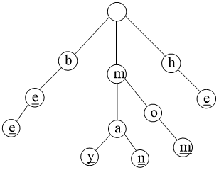
A trie for keys “be”, “bee”, “may”, “man”, “mom”, and “he”

Slide 19
Applications
1. Search for strings.
2. Word frequency statistics. Count how many times a word appears.
3. Sorting. Lexicographic sorting of a set of keys can be accomplished by building a trie from them, with the children of each node sorted lexicographically, and traversing it in pre-order, printing any values in either the interior nodes or in the leaf nodes.
4. Autocomplete. Tries can be used to return a list of keys with a given prefix.

Slide 20
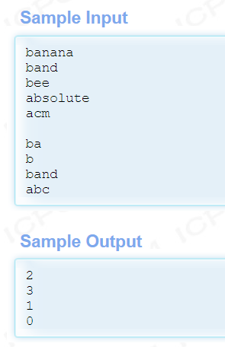
A statistical problem
There are many words, which are only composed of lowercase letters, and there will be no repeated words. Count the number of words prefixed with a certain string.

Slide 21
Method 1: map
#include <bits/stdc++.h>
using namespace std;
int main(){
char str[10];
map<string, int> m;
while(gets(str)){
int len = strlen(str);
if ( !len ) break; // input an empty line
for(int i = len; i > 0; i--){
str[i] = ‘\0’; //Delete the characters of this string
// one by one from back to front, to get the prefixes
m[str]++; //the number of words prefixed with str
}
}
while( gets(str) ) cout << m[str] << endl;
return 0;
}

Slide 22
Method 2: Using struct to implement the trie (MLE)
Insert(): new Trie MLE

Slide 23
Method 3: Using array to implement the trie
Compared with “struct”, “array” is more compact.

Slide 24
KMP
KMP searches for occurrences of a "word” (m) within a main "text string“ (n) by employing the observation that when a mismatch occurs, the word itself embodies sufficient information to determine where the next match could begin, thus bypassing re-examination of previously matched characters. It is the first linear-time algorithm for string matching.
the complexity is O(m + n). It is an optimal string matching algorithm, since at least n+m characters need to be processed.

Slide 25
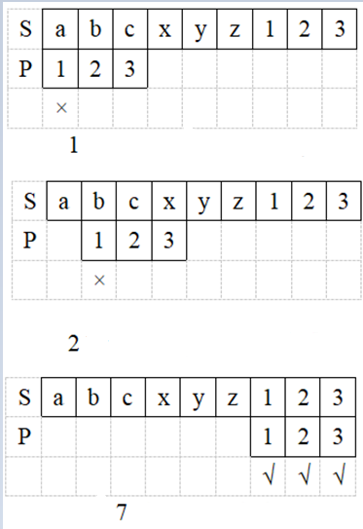
Brute force?
For all the characters of S, match each character of P one by one.
For example:
S=”abcxyz123”
P =”123”
Complexity: 6+3

Slide 26
When most of the characters of P and S are different, brute force performs well.
Each time when matching, the first character doesn’t match, and there is no need to match the remaining characters of P.
O(n+m)

Slide 27
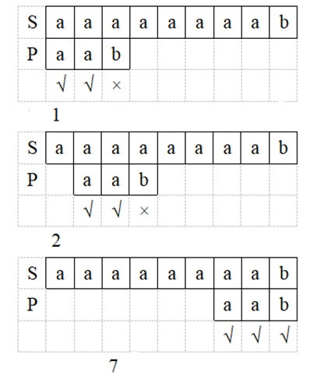
However,
If all the first m-1 characters of P match, and only the last one does not match, then the complexity is O(nm).

Slide 28
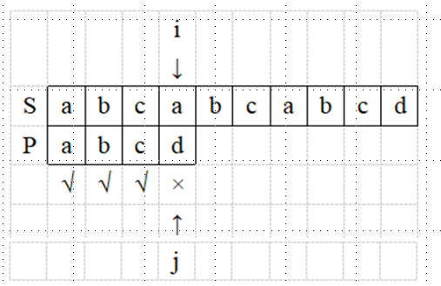
KMP: always O(n+m)
For exmaple: S[]=“abcabcabcd”, P[]=“abcd”
After the first round of matching, there is a mismatch at i=3, j=3.

Slide 29
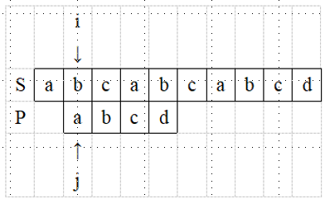
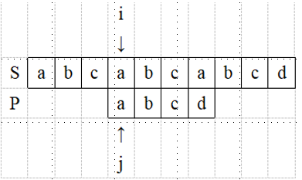
Brute force
˟
KMP
√
In the second round of matching, i and j return to i=1, j=0.
i doesn’t go back, just keep going forward
In the second round of matching, i=3 and only j returns to j=0.

Slide 30
The principle of KMP
The i pointer pointing to S doesn’t go back, and just go forward until the end.
Preprocess P and calculate the Next[] array. After a mismatch occurs, when the next match is performed, use Next[] to get the position of j’s backtracking.
https://blog.csdn.net/weixin_43914593/article/details/117533364

Slide 31
Compute Next[]
int Next[MAXN];
int getFail(char *p, int plen){
// for j’s backtracking when mismatching
Next[0]=0; Next[1]=0;
for(int i=1; i < plen; i++){
int j = Next[i];
while(j && p[i] != p[j]) j = Next[j];
Next[i+1] = (p[i]==p[j]) ? j+1 : 0;
}
}

Slide 32
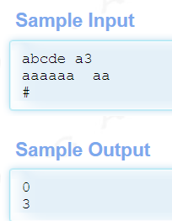
How many matches?
Count how many times the pattern string appears in the input string.

Slide 33
The Aho–Corasick algorithm
The AC algorithm: KMP+trie
KMP: a single-pattern matching algorithm
The AC algorithm: a multi-pattern matching algorithm. In a text string, find multiple different pattern strings simultaneously.

Slide 34
The Aho–Corasick algorithm
The AC algorithm is a kind of dictionary-matching algorithm that locates elements of a finite set of strings (the "dictionary") within an input text. It matches all strings simultaneously.
Informally, the algorithm constructs a finite-state machine that resembles a trie with additional links between the various internal nodes, which allows the automaton to transition between string matches without the need for backtracking.

Slide 35
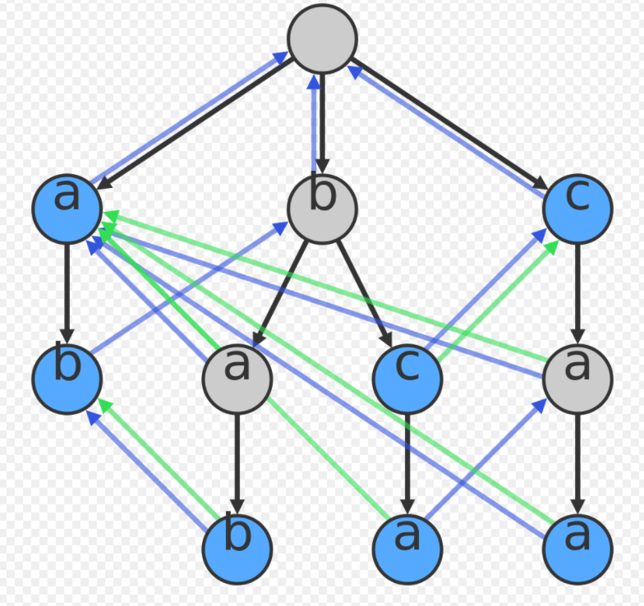
Example (Dictionary {a, ab, bab, bc, bca, c, caa})
A visualization of the trie for the dictionary. Suffix links (the longest possible strict suffix) are in blue; dictionary suffix links in green. Nodes corresponding to dictionary entries are highlighted in blue.

Slide 36
There is a blue directed "suffix" arc from each node to the node that is the longest possible strict suffix of it in the graph. For example, for node (caa), its strict suffixes are (aa) and (a) and (). The longest of these that exists in the graph is (a). So there is a blue arc from (caa) to (a). The blue arcs can be computed in linear time by performing a breadth-first search starting from the root. The target for the blue arc of a visited node can be found by following its parent's blue arc to its longest suffix node and searching for a child of the suffix node whose character matches that of the visited node. If the character does not exist as a child, we can find the next longest suffix (following the blue arc again) and then search for the character. We can do this until we either find the character (as child of a node) or we reach the root (which will always be a suffix of every string).
There is a green "dictionary suffix" arc from each node to the next node in the dictionary that can be reached by following blue arcs. For example, there is a green arc from (bca) to (a) because (a) is the first node in the dictionary (i.e. a blue node) that is reached when following the blue arcs to (ca) and then on to (a). The green arcs can be computed in linear time by repeatedly traversing blue arcs until a blue node is found, and memoizing this information.

Slide 37
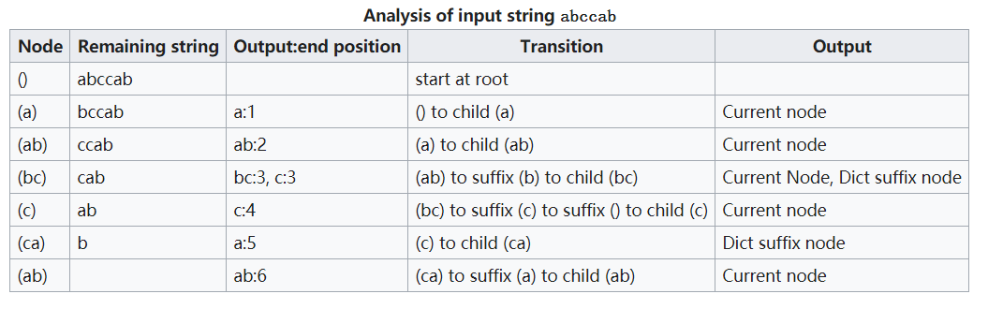
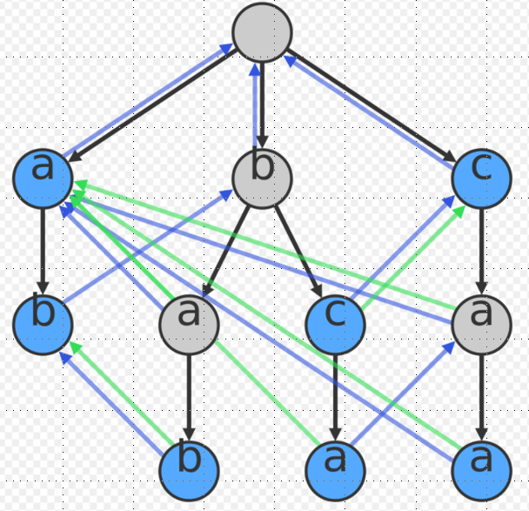
At each step, the current node is extended by finding its child, and if that doesn't exist, finding its suffix's child, and if that doesn't work, finding its suffix's suffix's child, and so on, finally ending in the root node if nothing's seen before.
When the algorithm reaches a node, it outputs all the dictionary entries that end at the current character position in the input text. This is done by printing every node reached by following the dictionary suffix links, starting from that node, and continuing until it reaches a node with no dictionary suffix link. In addition, the node itself is printed, if it is a dictionary entry.

Slide 38
Multi-pattern matching
Given an input string S with length of n and k pattern strings P1, P2, ..., Pk with an average length of m, find the positions where these pattern strings appear in S.
KMP: Do a kmp for each P1, P2,...Pk, and the total complexity is O((n + m)k).
The AC algorithm: Match all pattern strings simultaneously.

Slide 39
Complextity of the AC algorithm
Complexity
Buliding the trie: O(km)
Buliding links (getFail() BFS): O(km)
Matching: O(nm)
Total: O(km + km +nm)= O(km +nm)
Comparison with KMP：
KMP: O((n + m)k)，
When m << k, (k+n)m << (n + m)k

Slide 40
Keywords Search

